Slide 1

TID-E-ATHON
IDEA BUILDING COMPETITION
Agro RTC
Team Members:
M.Srilekha 20211A04B9
P.Likhitha 20211A04G7
A.Bhavana 21215A0403
Mentor:
R.Anirudh Reddy, Assistant Professor, BVRIT,Narsapur

Slide 2
INTRODUCTION
India is currently the world's third-largest producer of agricultural raw materials, roots and tuber crops, turmeric, potatoes, ginger, and a variety of vegetables.
Agriculture is our country's backbone. Harvesting is the most important aspect of agriculture. In general, harvesting takes more time and a large amount of manpower.
Harvesting underground crops such as turmeric, potatoes, carrots, ginger, and so on is a time-consuming process that involves reaping leaves and removing crops from the ground.
In the olden days, harvesting of underground crops was done by using sickles which completely needs manpower. Later on, as technology developed different machines were invented. Farmers are currently using two separate machines for reaping leaves and removing the crop from the ground.

Slide 3
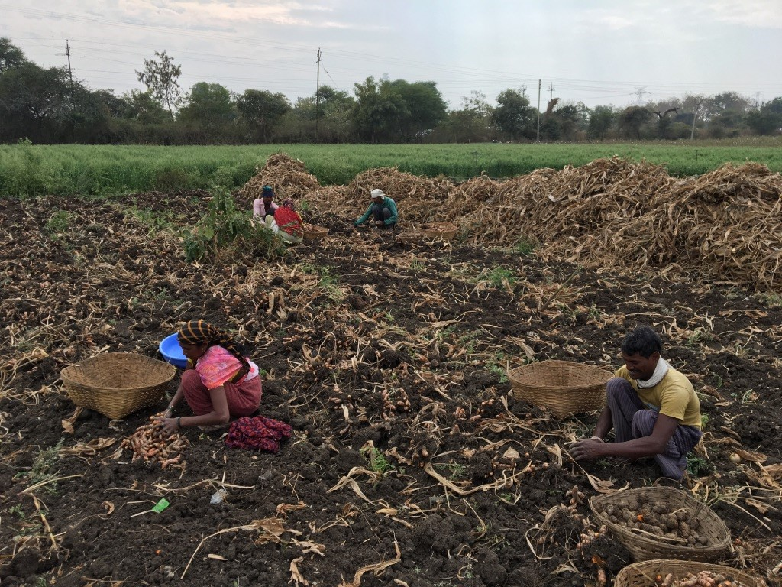
PROBLEM STATEMENT :
Lack of labor in Farming
Collecting picked crops requires
More time
Huge manpower

Slide 4
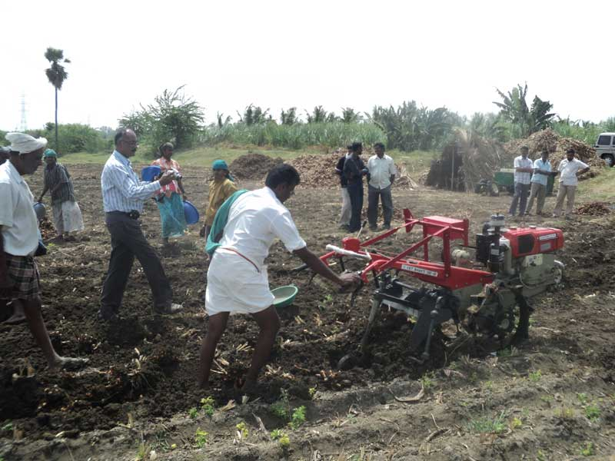
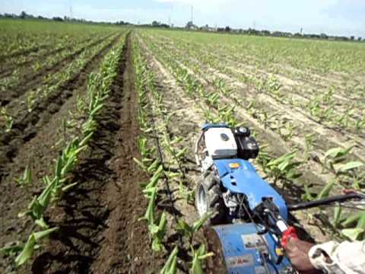
Wastage of crops when the harvesting is done manually
Using separate machines
Takes more time
Expensive
Consumes more fuel

Slide 5
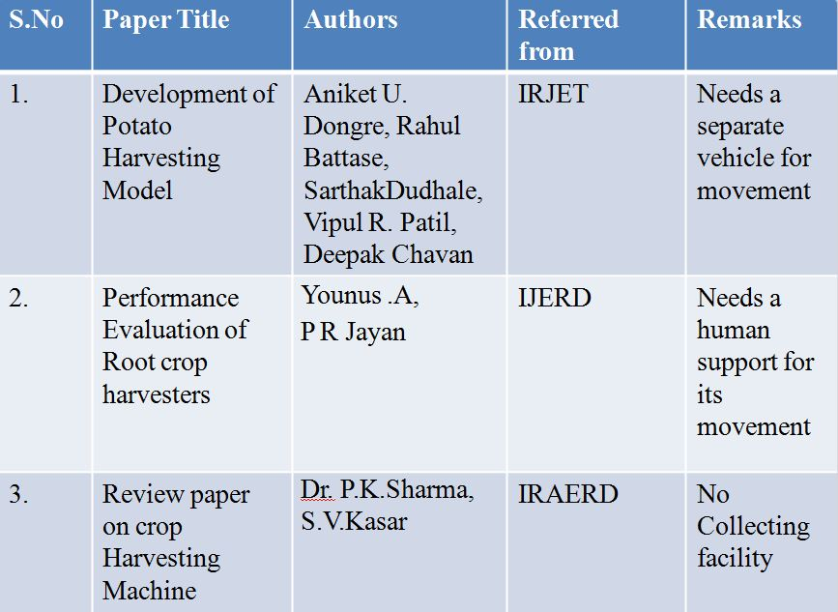
RELATED WORK

Slide 6
SOLUTION
To Design an Robotic System to cut the leaves and pick the onion from the ground, so that
There is no wastage of crop since it picks deep from the ground
Fuel Free Machine
Cost can be reduced by the use of a single machine
Mud can be detached from the crop by sieving process using the same machine
Collection of crops by Machine
Reduces Manpower
Saves Time

Slide 7
INNOVATION
Our prototype consists of a DC motor with two crossed blades, which are used for reaping the leaves.
we use a stepper motor along with spokes for taking out the crop from the ground
The picked crop is moved onto the conveyor belt which is in vibrating mode. Due to the continuous vibration, most of the mud gets detached from the crop
From the conveyor belt the crop gets collected in the bin and the ultrasonic sensor monitors the status of the bin and gives a buzzer.

Slide 8
OBJECTIVES
The main purpose of our project is to automate the harvesting methods of the tuber crops. They are mainly reaping, picking up crops, and collecting them.
The solution we are providing is a machine that can do the processes such as reaping leaves and picking the crop and collecting are done simultaneously.
We have a facility to operate the machine just by giving a command through mobile.

Slide 9
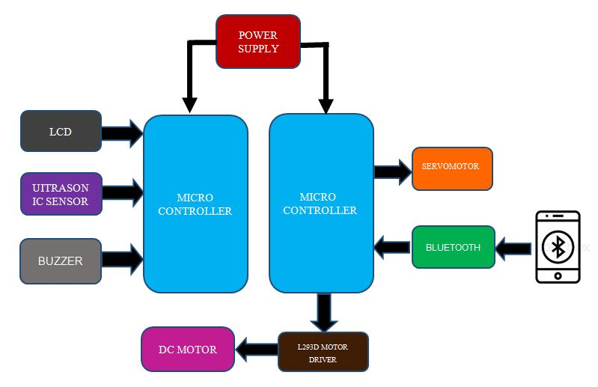
BLOCK DIAGRAM

Slide 10
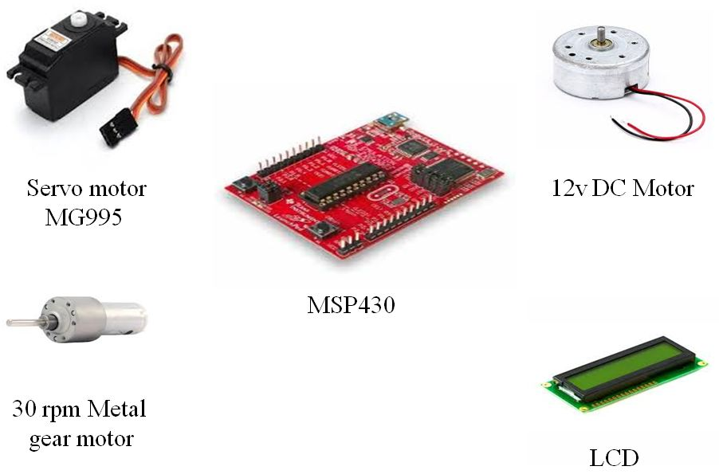
HARDWARE COMPONENTS

Slide 11
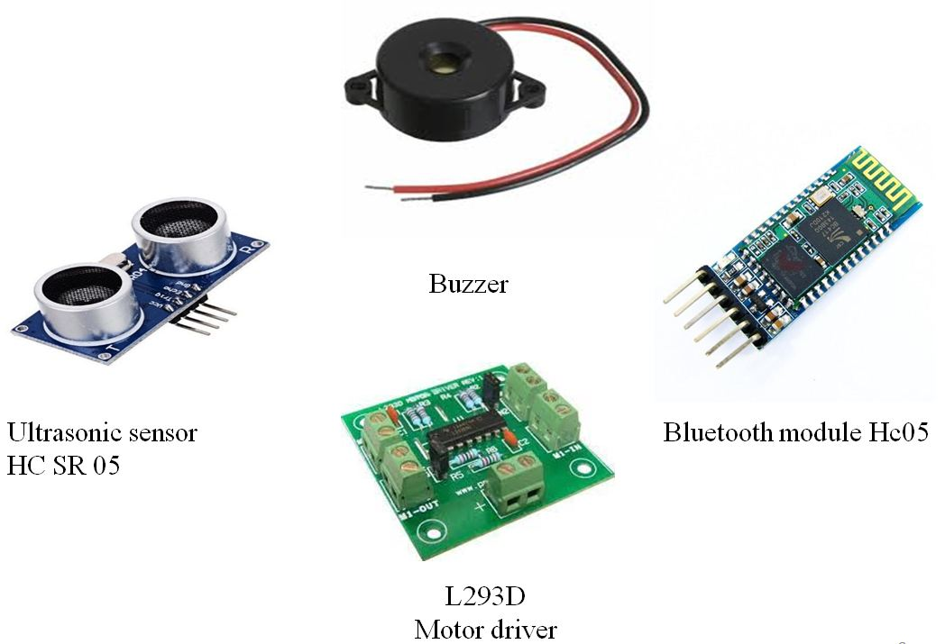

Slide 12
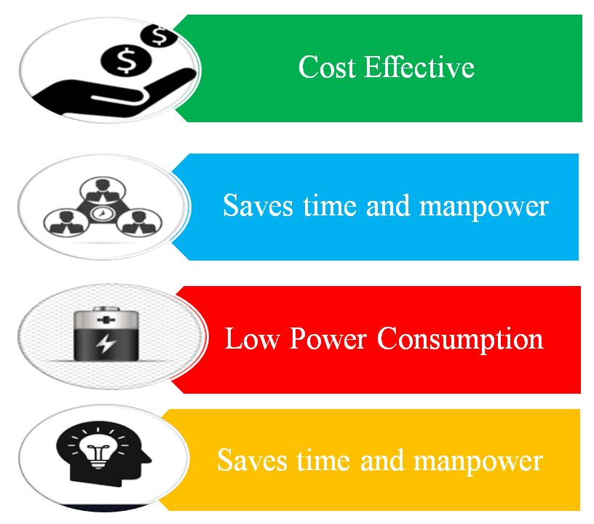
ADVANTAGES

Slide 13
PRODUCT AWARENESS
By conducting awareness programs in villages
Promotions are also made through social media, newspapers, magazines, radio, television, catalogs, leaflets, etc.
By telemarketing and conducting campaigns.
By email marketing.
APPLICATION
It is best suitable for harvesting tuber crops.
FUTURE SCOPE
This system can be further extended by using an adjustable ploughing part depending upon the height of the crop.

Slide 14
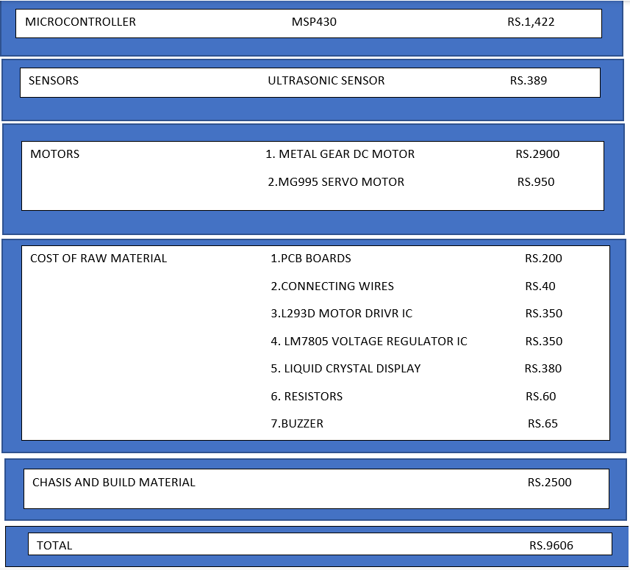
BUDGET ESTIMATION

Slide 15
PROJECT DURATION - 4 months
FOURTH MONTH
FINAL POC
FIRST MONTH
SECOND MONTH
THIRD MONTH
Individual peripherals interfacing for cutting, meshing and ploughing
Now we will integrate the parts into one unit and we will do software implementation
Testing & Validation
We will make the sketch of the design as per the requirements

Slide 16
TARGET AUDIENCE
The main target audience of our product are farmers who cultivate crops like onions,turmeric ,potatoes ,carrot ,ginger , radish etc.
Farmers who own medium and large scale farms.
COMPETITORS
Labors who follows conventional methods.
Fuel based machines separately for reaping and picking.

Slide 17
CONCLUSION
Agro RTC works efficiently and can be used for various tubers. As the bot does all the processes simultaneously, it takes less time for harvesting.
The directions and movement of the bot are controlled by using the application on mobile.
It consumes low power and is less expensive.

Slide 18


